Slide 1
Requirement Management & Project Planning

Slide 2
Requirement Management
Manage Requirements
Understand Requirements
Obtain Commitment to Requirements
Manage Requirements Changes
Maintain Bidirectional Traceability of Requirements
Ensure Alignment Between Project Work and Requirements
Checklist
Identify Stakeholders
Define Stakeholder requirements
Analyze requirements
Requirements Review Meeting
Record agreed upon requirements
List of identified Requirements
List of identified Requirements
Requirements List
Signed Requirements List

Slide 3
Requirements Breakdown
Stakeholder Requirements
(Management & Operational level)
Customer Intentions
Customer Requirements
System Weaver
Feature Requirements
Applied to
Functional Requirements
Software level Requirements

Slide 4
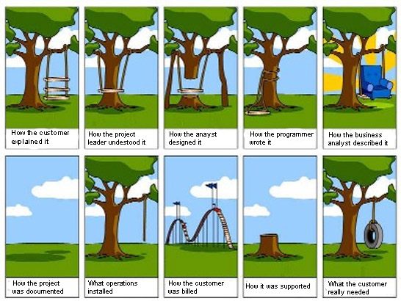

Slide 5
CMMI Project Planning
Establish Estimates
Estimate the Scope of the Project
Establish Estimates of Work Product and Task Attributes
Define Project Lifecycle Phases
Estimate Effort and Cost

Slide 6
CMMI Project Planning
Develop a Project Plan
Establish the Budget and Schedule
Identify Project Risks
Plan Data Management
Plan the Project’s Resources
Plan Needed Knowledge and Skills
Plan Stakeholder Involvement
Establish the Project Plan

Slide 7
CMMI Project Planning
Obtain Commitment to the Plan
Review Plans That Affect the Project
Reconcile Work and Resource Levels
Obtain Plan Commitment

Slide 8
Project Phases and Milestones
Content
Agreement
Confirmation
Validation
Production
Project
Closure
Define
Plan
Execution
Validate
Production Support

